Slide 1
OGK-2 Group
3M 2020 IFRS Results
May 15, 2020

Slide 2
Disclaimer
The information contained herein has been prepared using information available to JSC “OGK-2” (hereinafter - OGK-2 or the Company) at the time of preparation of the presentation. Since making a presentation, on the activities of OGK-2 and the content of the presentation could affect the external or other factors. In addition all relevant information about OGK-2 may not be included in this presentation. No representation or warranty, expressed or implied, is made as to the accuracy, completeness or reliability of the information.
Any forward looking information herein has been prepared on the basis of a number of assumptions which may prove to be incorrect. Forward looking statements, by the nature, involve risk and uncertainty. OGK-2 cautions that actual results may differ materially from those expressed or implied in such statements. Reference should be made to the most recent Annual Report for a description of the major risk factors.
This presentation does not constitute or form part of any advertisement of securities, any offer or invitation to sell or issue or any solicitation of any offer to purchase or subscribe for, any shares in OGK-2, nor shall it or any part of it nor the fact of its presentation or distribution form the basis of, or be relied on in connection with, any contract or investment decision.
OGK-2 Group 3M 2020 IFRS Results

Slide 3
Operational and Financial Highlights
Operational Highlights¹
Financial Highlights, mn RUR
 | 3M 2019 | 3M 2020 | Change
Electricity Output, mn kWh | 15,205 | 13,226 | -13.0%
Effective Electricity Output Without Regard to Financial Operations, mn kWh | 14,177 | 12,336 | -13.0%
Useful Heat Output, thousand Gcal | 2,267 | 2,148 | -5.2%
Fuel Rate on Electricity, g/kWh | 322.0 | 319.7 | -0.7%
Fuel Rate on Heat, kg/Gcal | 162.9 | 165.8 | +1.8%
Installed Capacity Load Factor, % | 37.5 | 31.8 | -15.2%
 | 3M 2019 | 3M 2020 | Change
Revenue | 37,538 | 34,350 | -8.5%
Operating Expenses, incl. | (28,745) | (23,836) | -17.1%
Variable Costs² | (18,985) | (16,712) | -12.0%
Fixed Costs² | (6,437) | (3,736) | -42.0%
Depreciation and Amortization | (3,323) | (3,388) | +2.0%
Reversal of Impairment Loss on Financial Assets | (230) | 74 | +132.2%
Operating Profit | 8,563 | 10,588 | +23.6%
EBITDA³ | 11,886 | 13,976 | +17.6%
Profit / Comprehensive Income for the Period | 6,262 | 7,937 | +26.7%
¹ Management report data
² Variable and fixed costs classification is based upon management report methodology
³ EBITDA = Operating profit + Depreciation and Amortization
OGK-2 Group 3M 2020 IFRS Results

Slide 4
Revenue
Revenue Structure, mn RUR
Prices and Tariffs¹
 | 3M 2020
Average electricity price at the free market, RUR/MWh | 1,199.93
Average heat tariff, RUR/Gcal | 841.33
Average price for new capacity, RUR/MW per month | 864,675.14
Average price for old capacity, RUR/MW per month | 141,516.36
Electricity and Capacity Revenue Structure for 3M 2020¹
Structure of Electricity Sales Volume at the Wholesale Market for 3M 2020¹
¹ Management report data
OGK-2 Group 3M 2020 IFRS Results

Slide 5
Variable Costs
Variable Costs Change Factors
Variable Costs Structure, mn RUR
Decrease of fuel expenses, purchased capacity and electricity expenses, as well as ecology payments, was due to lower electricity output in 3M 2020.
 | 3M 2019 | 3M 2020 | Change
Fuel Expenses | 16,001 | 14,720 | -8.0%
Purchased Electricity and Capacity | 2,941 | 1,980 | -32.7%
Ecology Payments | 43 | 12 | -72.1%
Total Variable Costs | 18,985 | 16,712 | -12.0%
Fuel Expenses, mn RUR
Fuel Consumption, thous. t¹
-12.0%
¹ Management report data
OGK-2 Group 3M 2020 IFRS Results

Slide 6
Fixed Costs
Fixed Costs and Depreciation Change Factors
Fixed Costs Structure, mn RUR
Fixed costs reduction was dew, mostly, to income from PP&E and other property sale, including property at Krasnoyarskaya station-2.
Other fixed costs grew on the account of exchange rate adjustments on service contracts.
 | 3M 2019 | 3M 2020 | Change
Employee Benefit | 2,291 | 2,411 | +5.2%
Rent Expenses | 1,190 | 1,254 | +5.4%
Taxes, Other than Income Tax | 727 | 718 | -1.2%
Repairs and Maintainance | 649 | 695 | +7.1%
Income from PP&E Disposal | (4) | (3,771) | -
Other Fixed Costs | 1,584 | 2,429 | 53.4%
Total Fixed Costs | 6,437 | 3,736 | -42.0%
Total Fixed Costs, mn RUR
Depreciation and Amortization, mn RUR
+2.0%
-42,0%
OGK-2 Group 3M 2020 IFRS Results

Slide 7
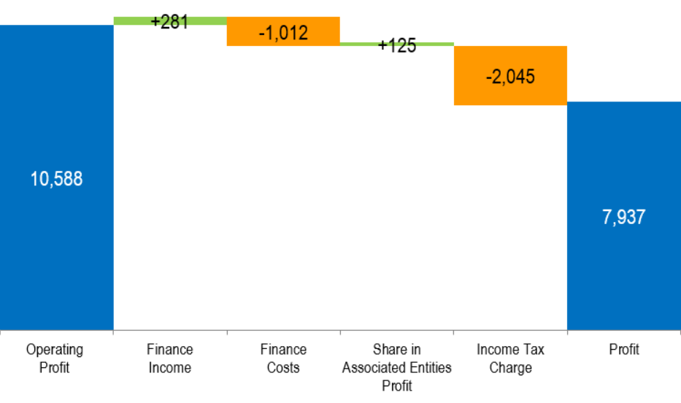
EBITDA and Profit
EBITDA, mn RUR
Profit Bridge for 3M 2020, mn RUR
+17.6%
OGK-2 Group 3M 2020 IFRS Results

Slide 8
Debt
Debt Structure, mn RUR
Debt Maturity Profile, as of March 31, 2020, mn RUR
Net Debt, mn RUR¹
Net Debt/ EBITDA
-33.2%
1.68
1.05
¹ Net debt = Total amount of borrowings less cash and cash equivalents
OGK-2 Group 3M 2020 IFRS Results

Slide 9
Thank You For Your Attention!
IR contacts:
Natalya Grizel
Tel.: + 7 (812) 646-13-64, ext. 2416
Email: Grizel.Natalya@ogk2.ru
OGK-2 Group 3M 2020 IFRS Results

