Slide 1
OGK-2 Group
9M 2021 IFRS Results
November 12, 2021

Slide 2
Disclaimer
The information contained herein has been prepared using information available to JSC “OGK-2” (hereinafter - OGK-2 or the Company) at the time of preparation of the presentation. Since making a presentation, on the activities of OGK-2 and the content of the presentation could affect the external or other factors. In addition all relevant information about OGK-2 may not be included in this presentation. No representation or warranty, expressed or implied, is made as to the accuracy, completeness or reliability of the information.
Any forward looking information herein has been prepared on the basis of a number of assumptions which may prove to be incorrect. Forward looking statements, by the nature, involve risk and uncertainty. OGK-2 cautions that actual results may differ materially from those expressed or implied in such statements. Reference should be made to the most recent Annual Report for a description of the major risk factors.
This presentation does not constitute or form part of any advertisement of securities, any offer or invitation to sell or issue or any solicitation of any offer to purchase or subscribe for, any shares in OGK-2, nor shall it or any part of it nor the fact of its presentation or distribution form the basis of, or be relied on in connection with, any contract or investment decision.
OGK-2 Group 9M 2021 IFRS Results

Slide 3
Operational and Financial Highlights
Operational Highlights¹
Financial Highlights, mn RUR
 | 9М 2020 | 9М 2021 | Change
Electricity Output, mn kWh | 33,530 | 37,356 | +11.4%
Effective Electricity Output Without Regard to Financial Operations, mn kWh | 31,253 | 35,000 | +12.0%
Useful Heat Output, thousand Gcal | 4,013 | 3,539 | -11.8%
Fuel Rate on Electricity, g/kWh | 325.5 | 335.1 | +2.9%
Fuel Rate on Heat, kg/Gcal | 166.1 | 166.2 | +0.1%
Installed Capacity Load Factor, % | 26.8 | 34.6 | +7.8 p.p.
 | 9М 2020 | 9М 2021 | Change
Revenue | 88,747 | 104,484 | +17.7%
Operating Expenses, incl. | (72,103) | (85,637) | +18.8%
Variable Costs² | (43,036) | (55,509) | +29.0%
Fixed Costs² | (29,067) | (30,128) | +3.7%
Impairment (Loss) / Reversal on Financial Assets | (604) | 386 | -
Operating Profit | 16,040 | 19,233 | +19.9%
EBITDA³ | 26,222 | 29,610 | +12.9%
Profit for the Period | 12,058 | 14,406 | +19.5%
Comprehensive Income for the Period | 12,003 | 14,563 | +21.3%
¹ Management report data
² Variable and fixed costs classification is based upon management report methodology
³ EBITDA = Operating profit + Depreciation and Amortization + Impairment Loss (Reserve Accrual) for Non-financial Assets - Income from Impairment Loss Reversal (Reserve) for Non-financial Assets
OGK-2 Group 9M 2021 IFRS Results

Slide 4
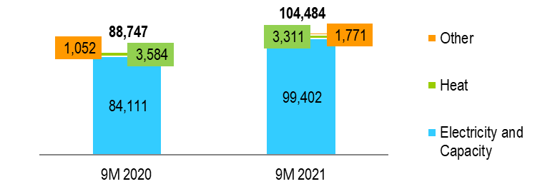
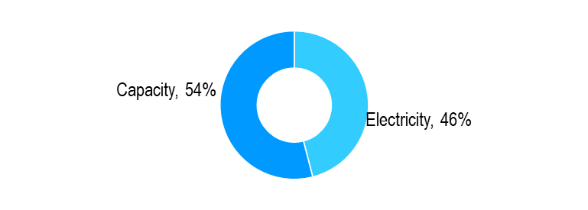
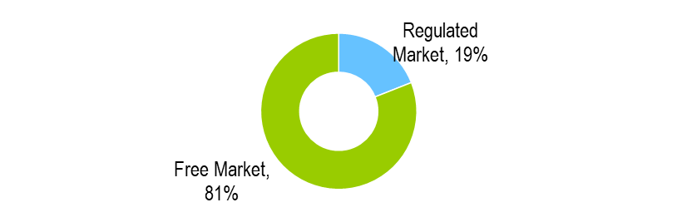
Revenue
Revenue Structure, mn RUR
Prices and Tariffs¹
 | 9M 2021
Average electricity price at the free market, RUR/MWh | 1,417.05
Average heat tariff, RUR/Gcal | 929.05
Average price for new capacity, RUR/MW per month | 1,119,359.99
Average price for old capacity, RUR/MW per month | 140,450.91
Electricity and Capacity Revenue Structure for 9M 2021 ¹
Structure of Electricity Sales Volume at the Wholesale Market for 9M 2021¹
¹ Management report data
OGK-2 Group 9M 2021 IFRS Results

Slide 5
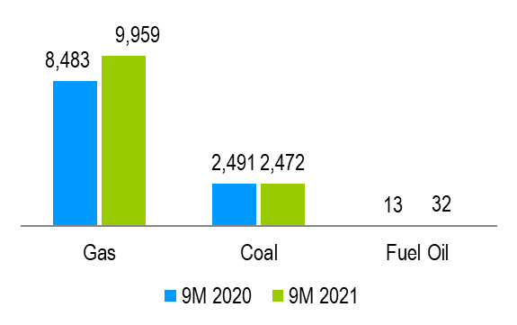
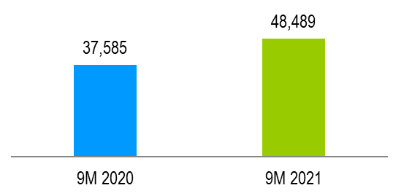
Variable Costs
Variable Costs Change Factors
Variable Costs Structure, mn RUR
Increase of fuel expenses resulted from generating equipment load rescheduling among stations, as well as electricity output and fuel prices increase .
Purchased capacity and electricity expenses growth was due to increased purchase volume and prices at the wholesale market for internal use, as well as in order to comply with regulated contracts, along with generating equipment load rescheduling among stations.
 | 9М 2020 | 9М 2021 | Change
Fuel | 37,585 | 48,489 | +29.0%
Electricity and Capacity | 5,451 | 7,020 | +28.8%
Total Variable Costs | 43,036 | 55,509 | +29.0%
Fuel Expenses, mn RUR
Fuel Consumption, thous. t¹
+29.0%
¹ Management report data
OGK-2 Group 9M 2021 IFRS Results

Slide 6
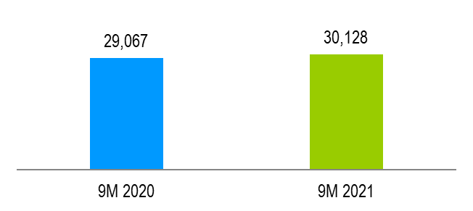
Fixed Costs
Fixed Costs and Depreciation Change Factors
Fixed Costs Structure, mn RUR
Fixed costs increase in 1H 2020 was dew to income from PP&E and other property sale, including property at Krasnoyarskaya station-2.
Rent expenses decreased on the account of Adlerskaya TPS rent termination, following its acquisition in December, 2020.
 | 9М 2020 | 9М 2021 | Change
Employee Benefit | 7,004 | 6,387 | -8.8%
Repairs and Maintainance | 2,643 | 2,646 | +0.1%
Electricity Market Administration | 1,767 | 1,680 | -4.9%
Taxes, Other than Income Tax | 1,964 | 1,929 | -1.8%
Rent | 3,885 | 1,325 | -65.9%
Loss (Income) from PP&E, Other Non-current Assets and Available for Sale Assets Disposal | (4,364) | 317 | -
Depreciation and Amortization | 10,185 | 10,377 | +1.9%
Other Fixed Costs | 5,983 | 5,467 | -8.6%
Total Fixed Costs | 29,067 | 30,128 | +3.7%
Total Fixed Costs, mn RUR
+3.7%
OGK-2 Group 9M 2021 IFRS Results

Slide 7
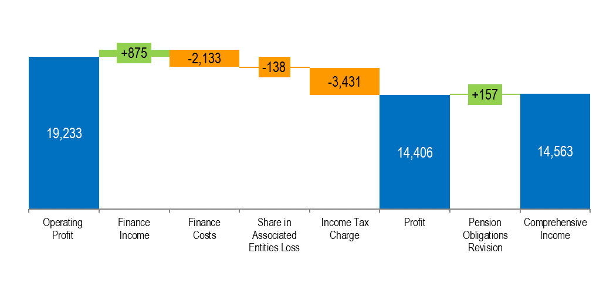
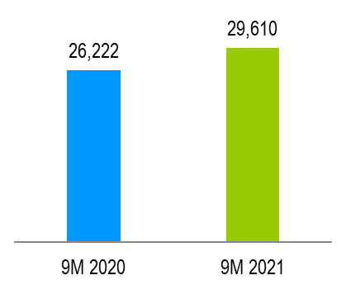
EBITDA and Profit
EBITDA, mn RUR
Profit Bridge for 9M 2021, mn RUR
+12.9%
OGK-2 Group 9M 2021 IFRS Results

Slide 8
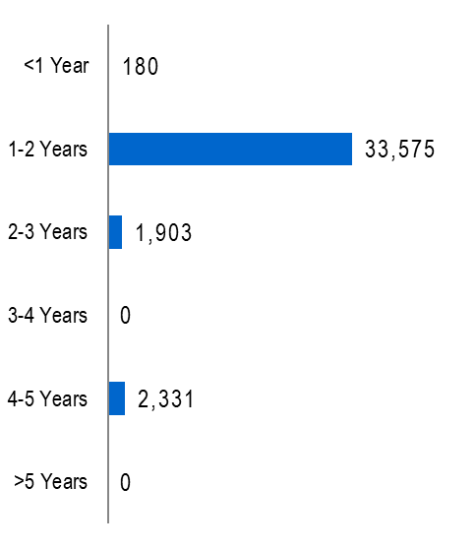
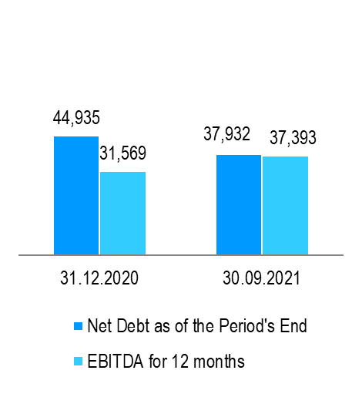
Debt
Debt Structure, mn RUR
Debt Maturity Profile, as of September 30, 2021, mn RUR
Net Debt, mn RUR¹
Net Debt/ EBITDA
-15.5%
1.32
1.01
¹ Net debt = Total amount of borrowings less cash and cash equivalents
OGK-2 Group 9M 2021 IFRS Results

Slide 9
Thank You For Your Attention!
IR contacts:
Natalya Grizel
Tel.: + 7 (812) 646-13-64, ext. 2416
Email: Grizel.Natalya@ogk2.ru
OGK-2 Group 9M 2021 IFRS Results

